Slide 1

Cardinal Consulting
Animikii Charter
Team #7

Slide 2
Project Introduction
YikeSite is a CMS created by local digital agency Animikii
Has not been updated and is now struggling to compete with other popular CMSs.
Users desire a modern, intuitive experience
Developers are bottlenecked by lack of modern web development tools and abilities

Slide 3
Background
YikeSite has a 15 year history
Developers and users are accustomed to its workflow despite pain points
Licensees have built businesses around it

Slide 4
Objectives
Improve usability by providing separate tools for presentation configuration and content storage
Adjust modern features such as live in-browser editing
Complete project without alienating 200+ current clients and licensees

Slide 5
Scope
Main focus is on providing a solution that will provide value to 4 identified key stakeholders
Developers
Our solution will address the confusion between webpage and data entities by introducing a new data store to the system. As a result webpage entities will be able to draw upon these data stores and eliminate the tree structure which this stakeholder as identified to be problematic
The new entities will provide a modular solution that will allow webpage entities to be able to add data elements that are able to be modified in browser. This offers a customizable back-end solution that aligns with the current niche of the market that Animikii finds itself in

Slide 6
Scope
Licensees
Our solution will comb existing entities that will be able to separate between webpage entities and data entities. The information will then be separated into the aforementioned web page structure, and data structure. As a result the licensees will not have to make any changes on their end, nor will their existing web pages change
CEO
By automating the extraction of existing data entities this prevents the tedious method of analyzing every entity of the current system and manually separating webpage from data entities. The perceived value of the CEO is the reduction of money spent on this potential analysis

Slide 7
Scope
Users
Will be able to add/modify webpages without having to worry about, nor be restricted by, the data that is being added
The modular approach would allows new features to be added to existing webpages without affecting any current functionaility if the user does not wish to use any new functions
In terms of value the user is offered more functionality, and a better user experience at the cost of nothing

Slide 8
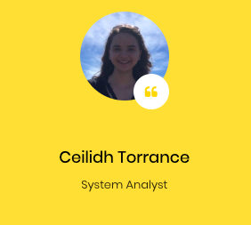
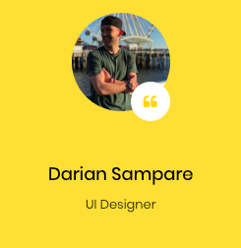
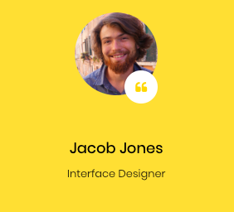
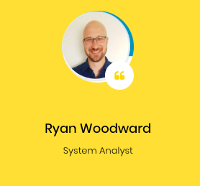
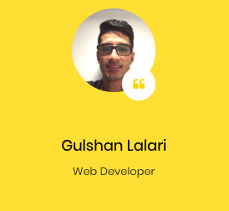
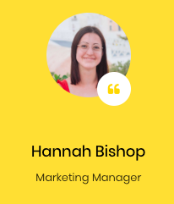
Meet the Team
Digital problem solvers with a diverse track record
Notes:
Ceilidh - set roles based on strengths, skills, and background

Slide 9
Approach
Agile methodology
1 week sprints
Weekly sprint planning on Fridays
Bi-weekly progress meetings with Animikii CEO
Weekly progress meetings with current Animikii developers to determine whether the modular solution is viable
Notes:
Ceilidh

Slide 10
Milestones
Project Charter - Oct. 15
Prototype - Nov. 5
Requirements - Nov. 6
Presentation - Nov. 19
Report - Dec. 4
Notes:
Ceilidh

Slide 11
Questions

